Slide 1
A Study Of The Book Of Revelation
October 18, 2020

Slide 2
Revelation
I. Struggle on Earth (1-11)
A. John’s Vision (1)
B. Letters to 7 churches (2-3)
C. God in control (4-5)
D. Opening of seven seals (6-11)
1. Chapter 7 – Interlude answering the question, “Who is able to stand?” (6:17)

Slide 3
The Great Multitude Coming Out of Tribulation
Revelation 7
Who is the “Great Multitude”?
Sealed servants of the earth (verses 2-8)
Sealed servants passed through death (verses 9-17)
God’s name written upon them
The 144,000 (7:3-4; 14:1-4)
Those who overcome (3:12; 22:4)

Slide 4
The Great Multitude Coming Out of Tribulation
Revelation 7
“Have washed their robes” and made them white in the blood of the Lamb!
Ephesians 1:7; Isaiah 1:18; Hebrews 9:14; (1:5)
Serve Him for that reason
144,000 sing before the throne!
“Day and night in His temple” sanctuary showing one service as priests
“The redeeming Lamb has become their providing Shepherd; he shall guide them to fountains of water of life, and God shall remove all grief from them.” (Ray Summers, Worthy Is The Lamb, Page 152)

Slide 5
The Great Multitude Coming Out of Tribulation
Revelation 7
Those who serve Him are cared for: (Note: 2 Corinthians 5:1-10; especially verses 6-8; Philippians 1:21-24; 1 Thessalonians 4:14; 3:13)
“Perfect protection”
Provision made for them (21:3)
“Perfect provision”
Not be hungry, thirsty, hot, or tormented (7:16)
“Perfect leading”
The Lamb is their Shepherd (22:1)
“Perfect joy”
Wipe away every tear from their eyes (21:1-4)

Slide 6
The Great Multitude Coming Out of Tribulation
Revelation 7
Therefore no tears will be in heaven. “He hath swallowed up death for ever; and the Lord Jehovah will wipe away tears from off all faces; and the reproach of his people will he take away from off all the earth: for Jehovah hath spoken it.” (Isaiah 25:8)
This same scene is presented again after the judgment, portraying the eternal condition of the Lord’s faithful (21:3-4; 22:1-5).

Slide 7
Revelation 8
“Opening of the Seventh Seal:
Four of the Seven Trumpets”
Outline
Opening of the Seventh Seal (vv. 1-6)
Four Trumpets Sounded (vv. 7-12)
Eagle Flying – Announces Woes from Remaining Trumpets (v.13)

Slide 8
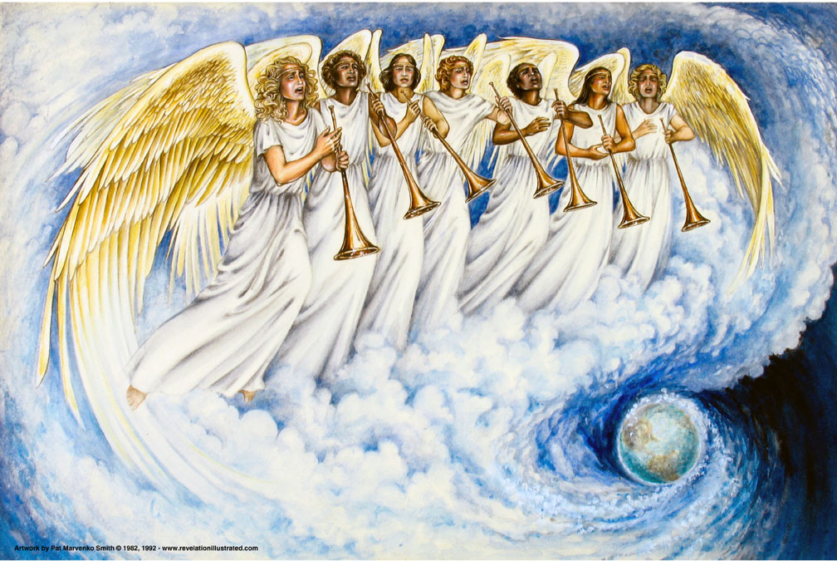
Revelation 8
The Seventh Seal –
Seven Angels with
Seven Trumpets

Slide 9

Revelation 8:1
Revelation 8
“And when he opened the seventh seal, there followed a silence in heaven about the space of half an hour.”

Slide 10
Revelation 8:2
Revelation 8
“And I saw the seven angels that stand before God; and there were given unto them seven trumpets.”

Slide 11
Silence in Heaven
Revelation 8
Silence in heaven for the “space of half an hour” as the seventh seal is opened.
What is the meaning of this “silence?”
“Calm before the storm?”
“Silence” increases the tension.
Impact on the judgments that are coming.
“But the LORD is in His holy temple. Let all the earth keep silence before Him.” (Habakkuk 2:20; Zephaniah 1:7; Zechariah 2:13; cf. Revelation 4:9-11, Revelation 5:8-14, Revelation 7:9-12)

Slide 12
Seven Angels – Seven Trumpets
Revelation 8
Angels standing “ready” to carry forth His message.
Each is given a trumpet.
Purpose of “trumpets?”
Assemble for a meeting (Numbers 10:3; Joel 2:1, 15)
To move the people. (Numbers 10:5)
Alarm for war (Numbers 10:9; cf. Ezekiel 33:3; Hosea 5:8) Likely this use in our text.
Times of festivity (Numbers 10:10)

Slide 13
Seven Angels – Seven Trumpets
Revelation 8
Purpose of “trumpets?”
To call the wicked to repent?
Used as a warning and call to judgment:
7 seals – introduce judgments
7 trumpets – announce judgment
7 bowls of wrath – judgment
Warning of Judgment
Call to Repentance

Slide 14
Revelation 8:3
Revelation 8
“And another angel came and stood over the altar, having a golden censer; and there was given unto him much incense, that he should add it unto the prayers of all the saints upon the golden altar which was before the throne.”

Slide 15
Revelation 8:4
Revelation 8
“And the smoke of the incense, with the prayers of the saints, went up before God out of the angel's hand.”

Slide 16
Another Angel
Revelation 8
God’s awareness and prayers of the saints
Angel was given a great quantity of “incense” to add to the prayers of the saints. (Revelation 5:8; 6:9-11; James 5:16)
“Censer” was a firepan in which hot coals from the altar were placed. Grains of incense were burned on the coals to produce a sweet smell before the Lord.
Leviticus 16:12,13; cf. Luke 1:8-10
Luke 18:1-8, “Ought always to pray, and not to faint … And shall not God avenge his elect, that cry to him day and night, and (yet) he is longsuffering over them?”

Slide 17
Altar of Incense
Revelation 8
This scene preceding the sounding of the first trumpet symbolizes the prayers of the saints ascending, like incense, unto God.
“Much incense” might represent the Savior’s intercession in heaven for the saints.
Hebrews 7:25
Romans 8:26-27, 34
Ingredients needed for the prayers to come before God’s throne!

Slide 18
Revelation 8:5
Revelation 8
“And the angel taketh the censer; and he filled it with the fire of the altar, and cast it upon the earth: and there followed thunders, and voices, and lightnings, and an earthquake.”

Slide 19
Sounds in Heaven
Revelation 8
The censer that offered the incense is filled with fire taken from the altar.
Fire strikes the earth, causing thunder, voices, lightning, and an earthquake – all symbolical of God’s response.
All this expresses certainty that God hears and answers the prayers of His people. (Exodus 2:23-24; 1 Peter 3:12; 1 Peter 2:5; 1 Timothy 2:5; 1 Thessalonians 5:17; Philippians 4:6).
God always warns first – then comes judgment! Amos 3:3, 7; 2 Peter 3:9

